Slide 1
Haoting Shen
Zhejiang University

Slide 2
Disclaimer
Many images and resources used in this lecture are collected from the Internet, and they are used only for the educational purpose. The copyright belong to the original owners, respectively.
Part of slides credit to
CSAPP @ CMU
Prof. Yabo Dong @ ZJU
Dr. Jun Lu, Peiking Univ.
Coursera.org

Slide 3

Source Code -> Executable File
C
int x = 10;
x = 2 * x + 15;
compiler
r0 = 0
r5 = r0 + 10
r5 = r5 * 2
r5 = r5 + 15
RISC-V
assembly
language
addi r5, r0, 10
muli r5, r5, 2
addi r5, r5, 15
Everything is a number!
assembler
10 r0 r5 op = addi
RISC-V
machine
language
00000000101000000000001010010011
00000000000100101001001010010011
00000000111100101000001010010011
15 r5 r5 op = addi

Slide 4
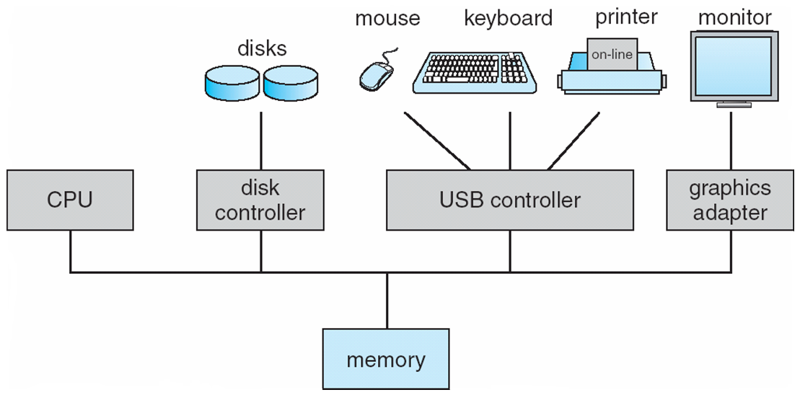
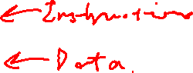
Von-Neumann Model
CPU
Memory
I/O
System
Amazingly, it’s still possible to think of the computer this way at a conceptual level (model from ~80 years ago!!!)
A computer today has
some differences

Slide 5

Conceptual View of Memory
address | content
0000 0000 0000 0000 | 0110 1110
0000 0000 0000 0001 | 1111 0100
0000 0000 0000 0010 | 0000 0000
0000 0000 0000 0011 | 0000 0000
0000 0000 0000 0100 | 0101 1110
0000 0000 0000 0101 | 1010 1101
0000 0000 0000 0110 | 0000 0001
0000 0000 0000 0111 | 0100 0000
0000 0000 0000 1000 | 1111 0101
... | ...
At address 0000 0000 0000 0010
the content is 0000 0000

Slide 6
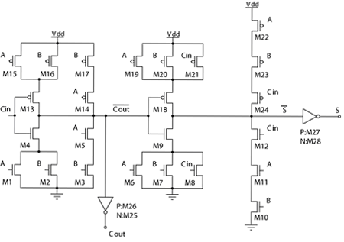
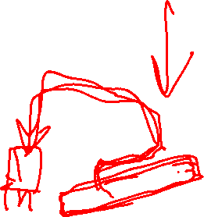
Transistor Schematic
Full adder
Very Large Scale Integrated (VLSI) Circuit

Slide 7
Covered in ZJU Computer System Courses
Application
Compiler / Libraries of Macros and Procedures
Software
Operating System (OS)
System-II&III
Instruction Set Architecture (ISA)
Computer Organization (Micro Architecture)
System-I
Register Transfer Level (RTL)
Hardware
Digital Logic Circuit (DLC)
Device Technology

Slide 8
ZJU Computer System Courses
System Security
YOUR ADVANCED KERNEL based on YOUR OWN CPU!
System I
System II
System III
YOUR FIRST KERNEL based on YOUR OWN CPU!
YOUR OWN CPU!
Operating System
Computer Organization
Computer Architecture
Digital Logic
8
Notes:
Add security

Slide 9
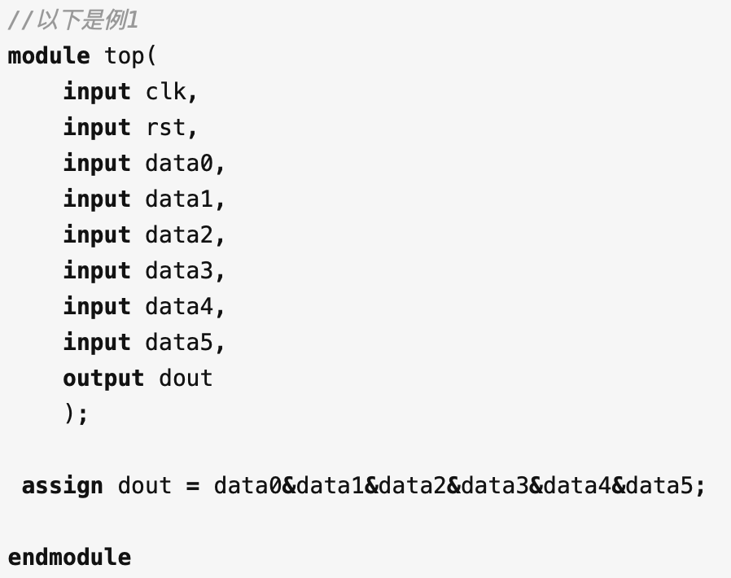
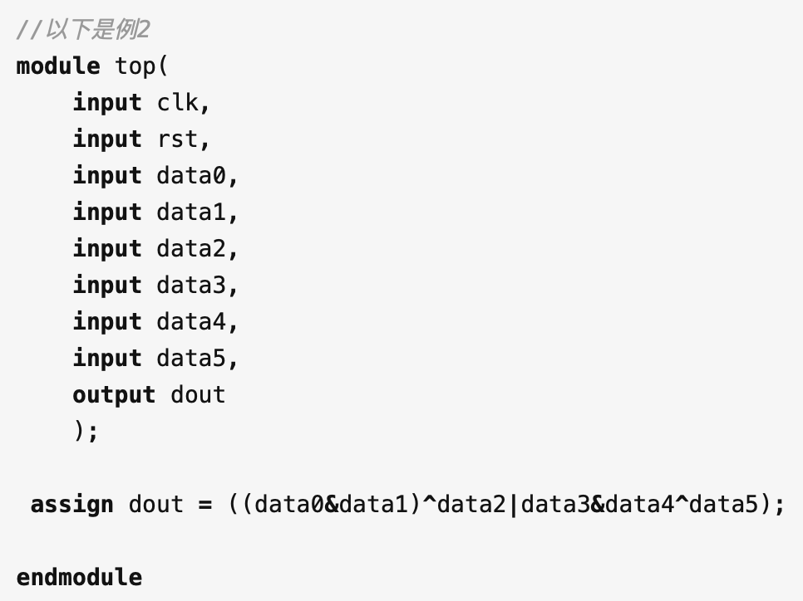
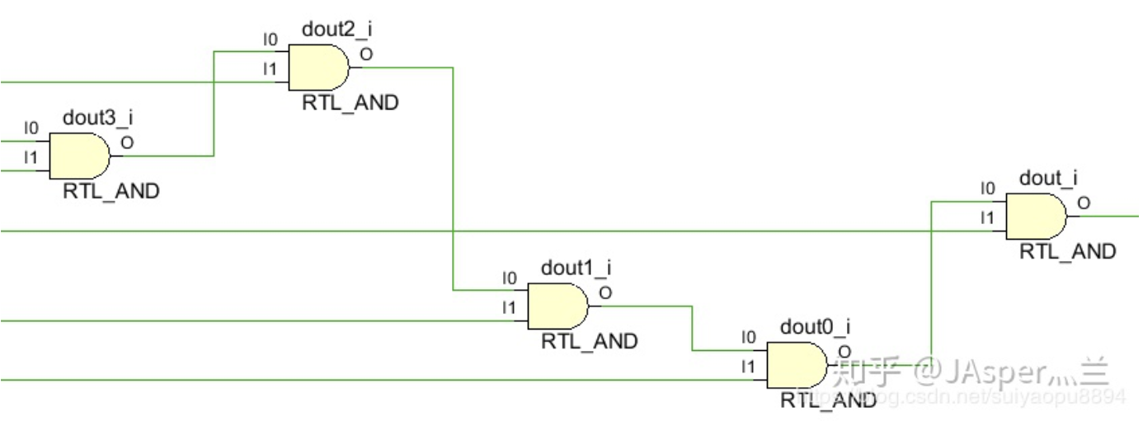
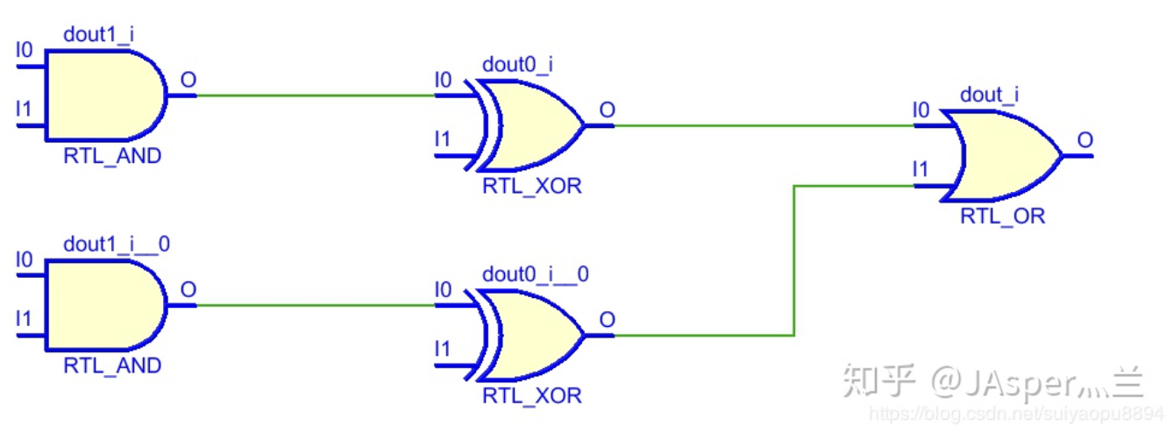
LUT

Slide 10
Overview
Introduction to computer systems
Binary number representation
Arithmetic operations
Representation of numeric data
Representation of non-numeric data
Data width and storage

Slide 11
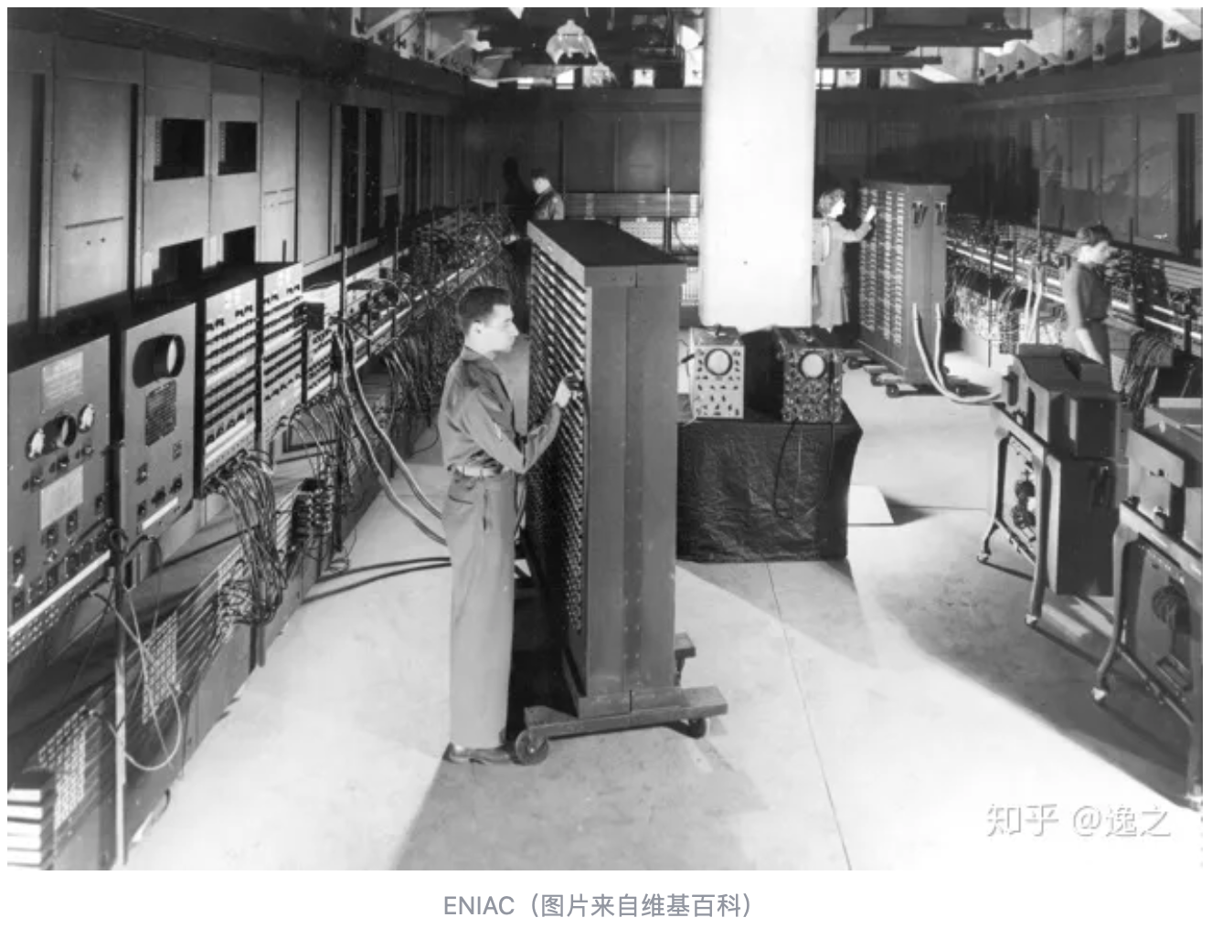
ENIAC
ENIAC (Electronic Numerical Integrator and Computer)
EE@Upenn
Funded by the U.S. Army's Ballistics Research Laboratory to calculate missiles
Use mechanical switches, manual wire connections, and other settings to implement instructions.

Slide 12
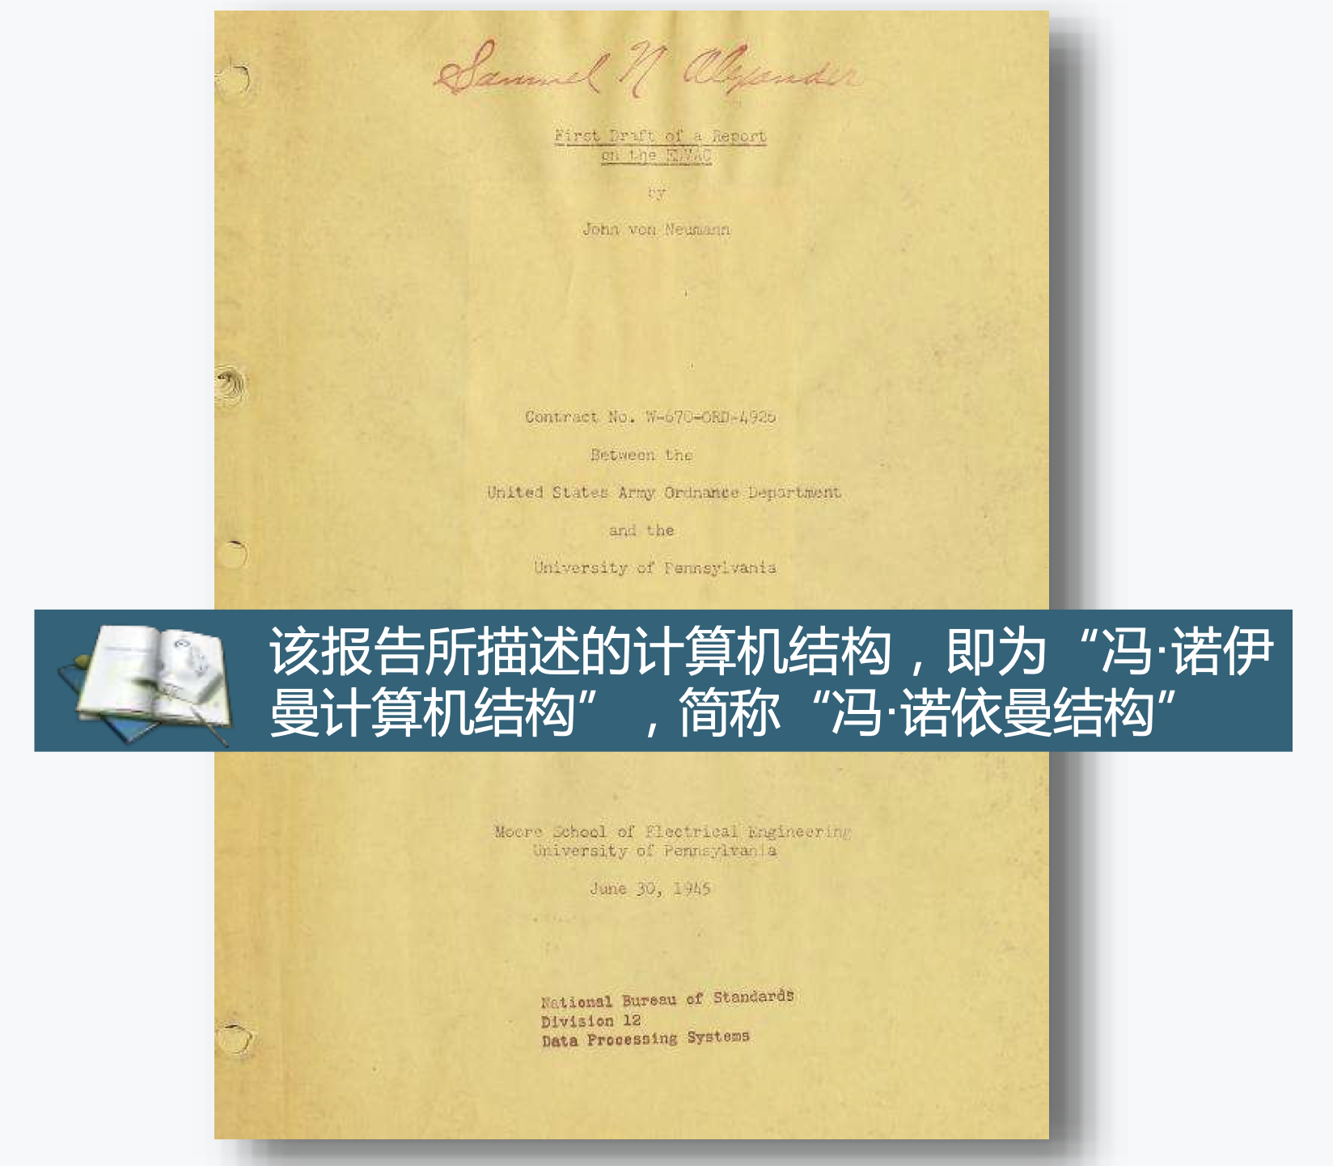
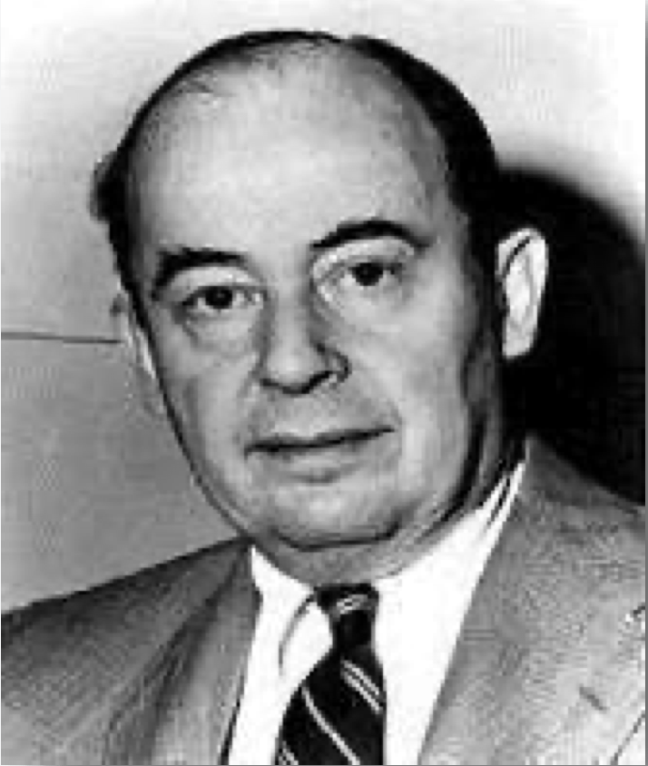
Von Neumann and EDVAC
The Von Neumann architecture was firstly described in First Draft of a Report on the EDVAC
John Von Neumann
1903~1957

Slide 13
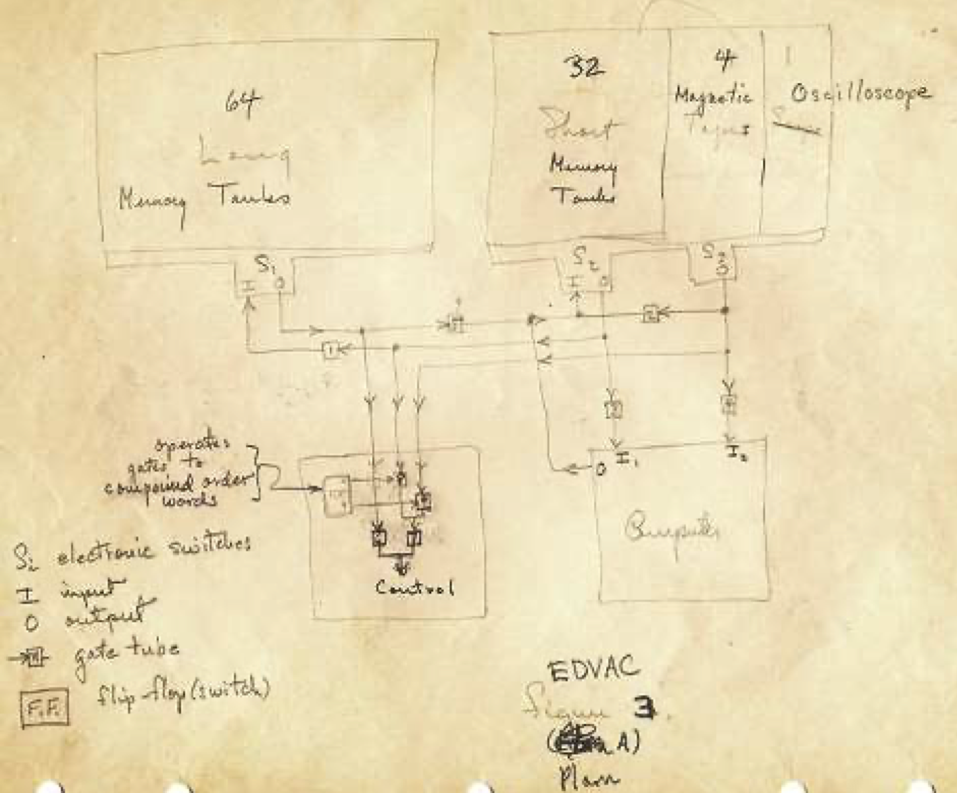
Von Neumann and EDVAC
101 pages, unfinished manuscript
Tow important conceptions
Stored program
Binary
5 parts
Central Arithmetical (CA)
Central Control (CC)
Memory (M)
Input (I)
Output (O)

Slide 14
Von-Neumann Model
CPU
Memory
I/O
System
Amazingly, it’s still possible to think of the computer this way at a conceptual level (model from ~80 years ago!!!)
A computer today has
some differences

Slide 15
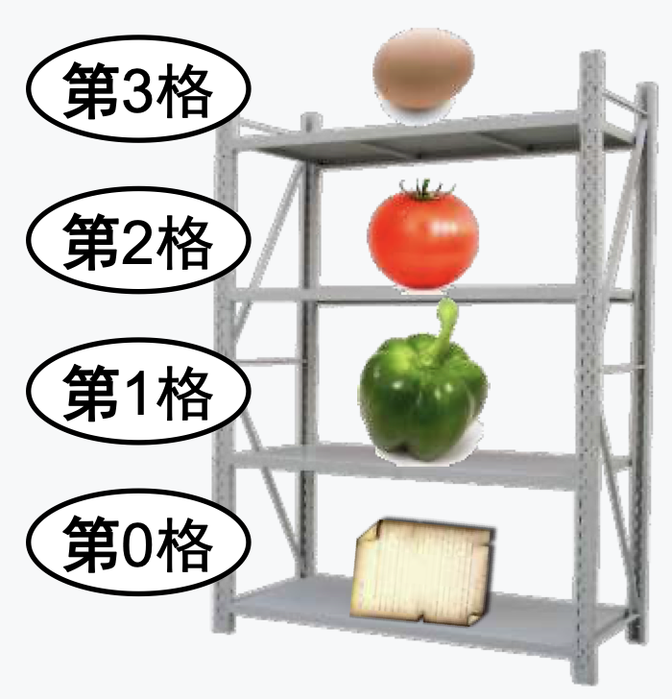
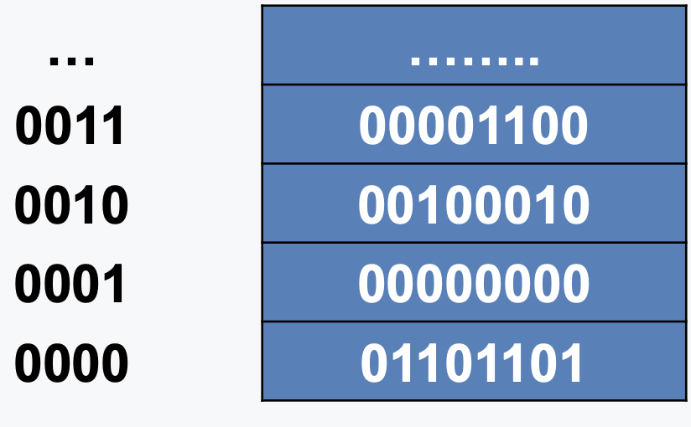
Main Memory (also called RAM)
Address
Content
3rd
High address
2nd
1st
Low address
0th

Slide 16
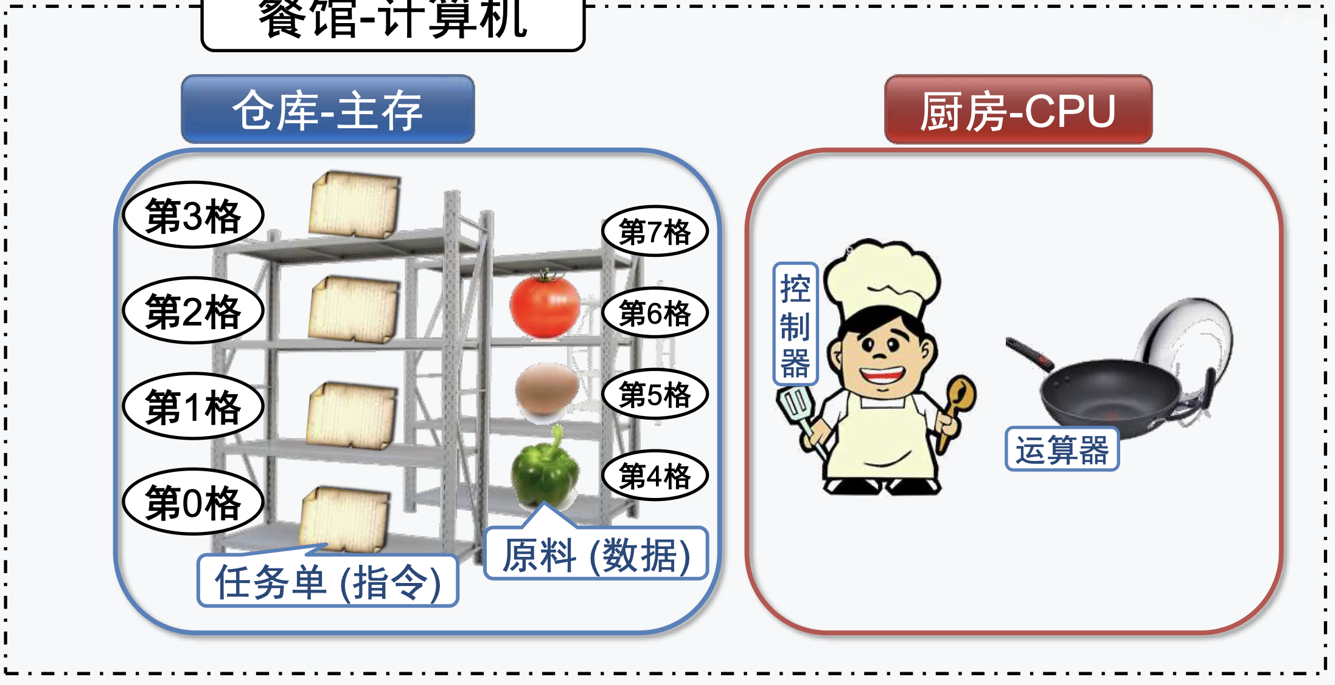
Von Neumann Computer Vs. Restaurant
Restaurant - Computer
Storage - Memory
Kitchen - CPU
3rd
7th
2nd
6th
Control
1st
5th
Arithm.
4th
0th
Raw food - Data
To-do list - Instructions

Slide 17

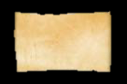
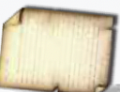
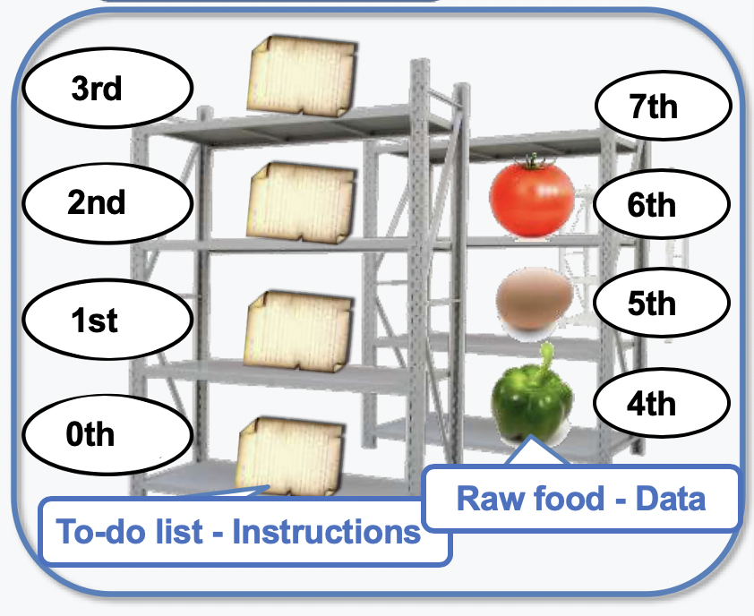
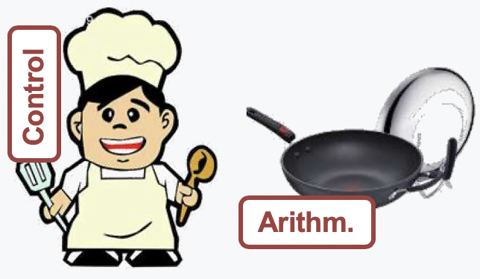
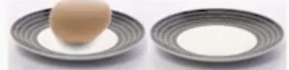
Von Neumann Computer Vs. Restaurant
Need Task on 1st
Next step: on 1st
Task
Current task
Kitchen - CPU
Memory
Control
Arithm.
General Purpose Registers (GPRs)

Slide 18


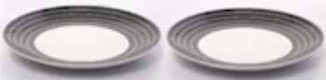
Von Neumann Computer Vs. Restaurant
How to cook: fry
Raw food: 6th and disk A
Where to leave: disk A
Next step: on 2nd
Fetch 6th
Fetch disk A
Fry
Put into disk A
Task
Memory
Control
CPU
Arithm.
General Purpose Registers (GPRs)

Slide 19
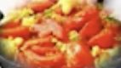
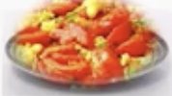
Von Neumann Computer Vs. Restaurant
How to cook: fry
Raw food: 6th and disk A
Where to leave: disk A
Next step: on 2nd
Fetch 6th
Prepare disk A
Fry
Put into disk A
Task
Memory
Control
CPU
Arithm.
General Purpose Registers (GPRs)

Slide 20
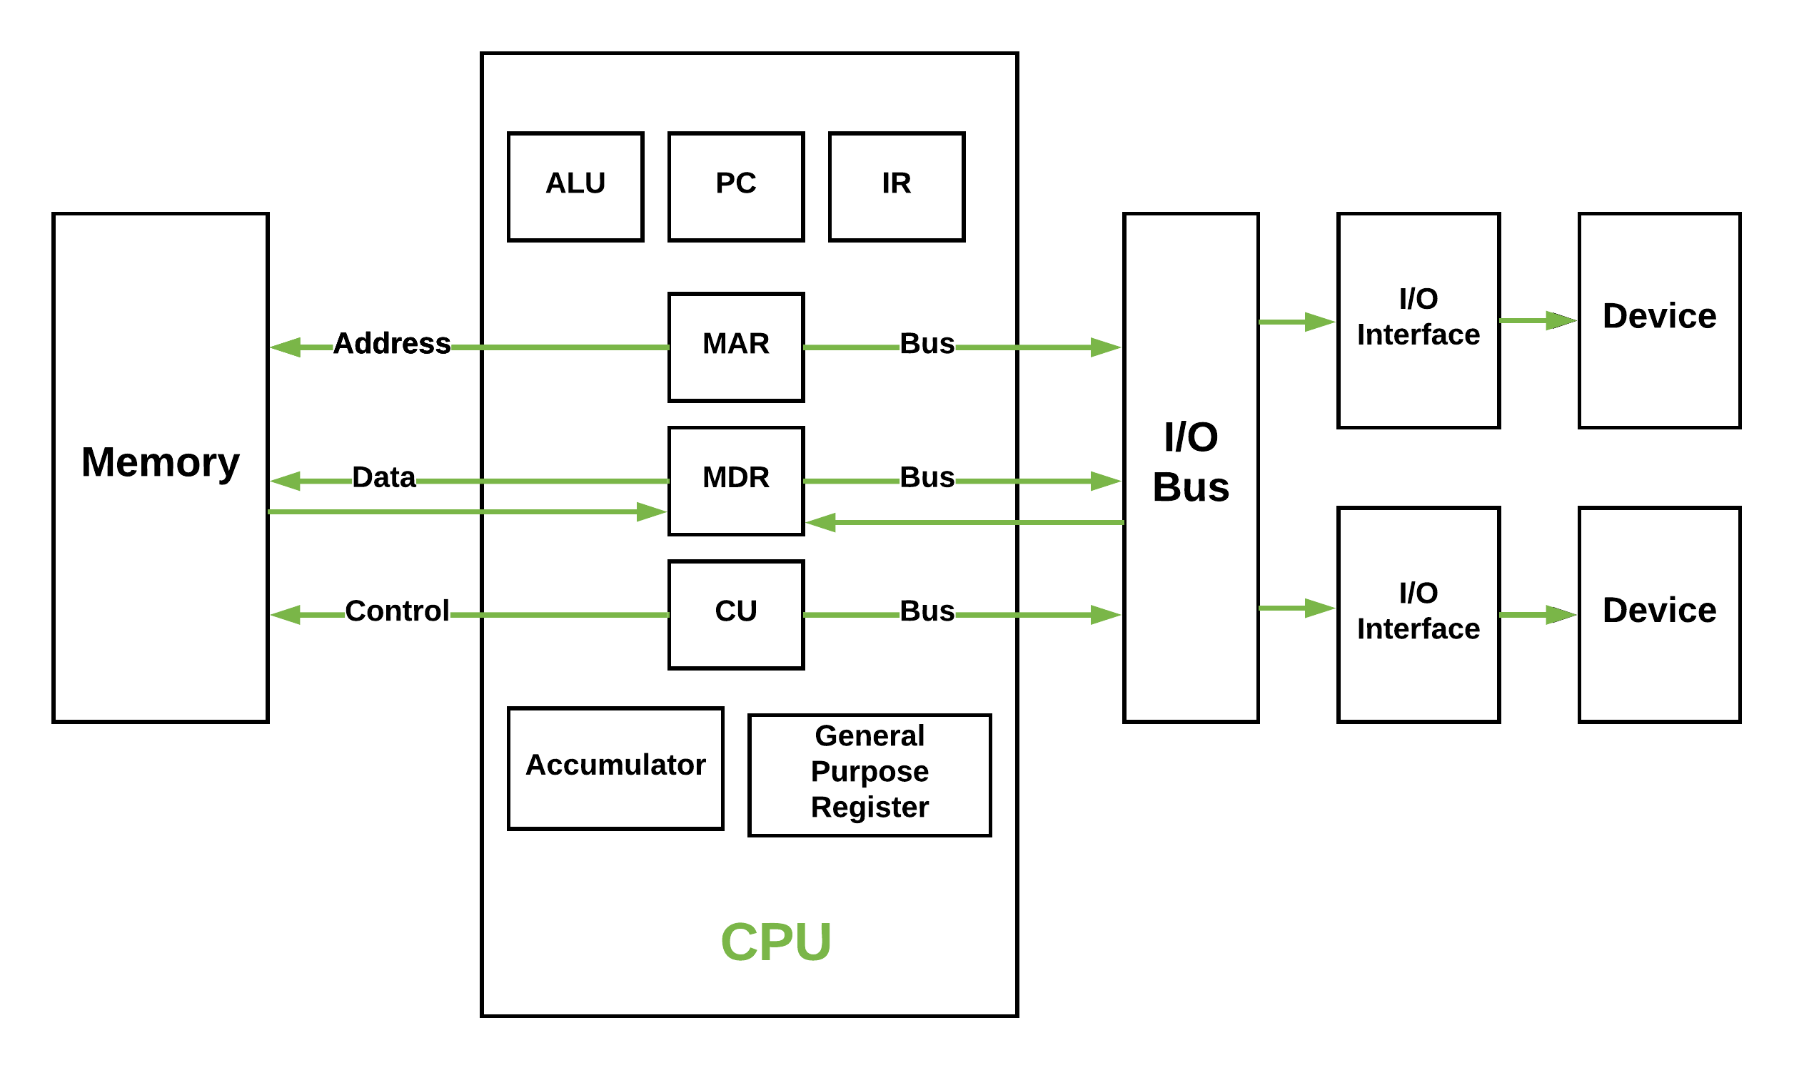
Details in Von-Neumann Model
https://media.geeksforgeeks.org/wp-content/uploads/vn_cpu.png
Notes:
存储程序（stored program）
由5个部件组成：运算器、控制器、存储器、输入设备、输出设备
存放数据和指令，形式上没有区别，但计算机可区分。控制器自动控制指令的执行，运算器执行算术和逻辑运算；操作人员可通过输入输出设备使用计算机。
计算机内部已二进制形式表示指令和数据，指令由操作码和地址码两部分组成，操作码指出操作类型，地址码给出操作数地址；一串指令构成程序。
PC：ProgramCounter，程序计数器
CU：Control Unit，控制单元（部件），为控制器的核心部件，其功能是产生微操作命令序列
ALU：ArithmeticLogic Unit，算术逻辑运算单元，为运算器的核心部件，其功能是进行算术、逻辑运算。
总线：地址线、数据线、控制线
CPU -> 地址线: 主存地址寄存器（Memory Address Register, MAR）
CPU <-> 数据线: 主存数据寄存器（Memory Data Register, MDR）

Slide 21
Program Representation and Execution
Program Representation
Program Execution

Slide 22
Program Representation
Instructions
0/1 binaries
Program Language
Low Level Language
Machine Language
Assembly Language
High Level Language
C
Java
……
Translator
Assembler
Interpreter
Compiler
Notes:
Assembler（汇编程序/汇编器）：汇编语言 -> 机器语言
Interpreter（解释程序/解释器）：源程序语句逐条翻译机器指令并立即执行
Compiler（编译程序/编译器）：高级语言 -> 汇编语言/机器语言目标

Slide 23
Program Execution
Execute Instructions Automatically
Instruction Fetch
Instruction Decode
Execute
Memory Access
Write Back
Notes:
程序由指令构成，程序的执行就是周而复始执行一条条指令的过程。
程序执行前，首先将程序的起始地址存放在PC。

Slide 24
Overview
Introduction to computer systems
Binary number representation
Arithmetic operations
Representation of numeric data
Representation of non-numeric data
Data width and storage

Slide 25
INFORMATION REPRESENTATION - Signals
Information variables represented by physical quantities.
For digital systems, the variables take on discrete values.
Two level, or binary values are the most prevalent values in digital systems.
Binary values are represented abstractly by:
digits 0 and 1
words (symbols) False (F) and True (T)
words (symbols) Low (L) and High (H)
and words On and Off.
Binary values are represented by values or ranges of values of physical quantities

Slide 26
Signal Examples Over Time
Time
Continuous in value & time
Analog
Digital
Discrete in value & continuous in time
Asynchronous
Synchronous
Discrete in value & time

Slide 27
Signal Example – Physical Quantity: Voltage
Threshold Region
Notes:
The HIGH range typically corresponds to binary 1 and LOW range to binary 0.
The threshold region is a range of voltages for which the input voltage value cannot be interpreted reliably as either a 0 or a 1.

Slide 28
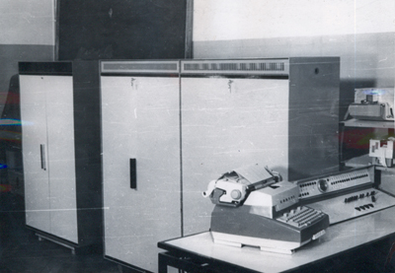
Why Binary?
Setun (Сетунь)
A balanced ternary computer developed in 1958 at Moscow State University
The only modern ternary computer, using three-valued ternary logic
Is binary the most efficient one in digital systems?
Setun-70 in 1970
Notes:
Why binary?
https://www.zhihu.com/question/20830886
从物理实现来说，第一，二进制状态简单；第二，可靠性、稳定性高；第三，运算规则简单，简化设计；第四，通用性强。
用电压的开关，电流的有无都能表示二进制的2种稳定状态，而要表示十进制的10个稳定状态则困难得多，从而二进制带来了更高的可靠性。
另外，二进制的加法运算比十进制更为简单，简化了运算器等物理器件的设计。还有，在计算机cpu的算数逻辑单元中，0和1可以清楚的表示真假，对错的逻辑运算，使得电子机械完成计算的通用性加强
https://www.howtogeek.com/367621/what-is-binary-and-why-do-computers-use-it/#:~:text=Computers%20don't%20understand%20words%20or%20numbers%20the%20way%20humans%20do.&text=To%20make%20sense%20of%20complicated,states%20your%20computer%20can%20understand.
Ternary logic is way more efficient than binary, but as of yet, nobody has an effective replacement for the binary transistor, or at the very least, no work’s been done on developing them at the same tiny scales as binary.
The reason we can’t use ternary logic comes down to the way transistors are stacked in a computer—something called “gates”—and how they’re used to perform math. Gates take two inputs, perform an operation on them, and return one output.
This brings us to the long answer: binary math is way easier for a computer than anything else. Boolean logic maps easily to binary systems, with True and False being represented by on and off. Gates in your computer operate on boolean logic: they take two inputs and perform an operation on them like AND, OR, XOR, and so on.

Slide 29
External information and internal data
Continuous vs. discrete
Advanced types vs. primitive types
Notes:
计算机只能表示和处理离散信息，数字化编码过程机将现实世界连续信息转化为离散的样本信息，用0/1进行编码表示。
十进制正负数，也必须用二进制0/1表示。

Slide 30
External Information
Text, image, sound, video, etc.
User’s perspective
Input Device
Output Device
Data represented by binary-encoding
Structural data
(e.g., graph, tree, link table, queue)
High-level programmer’s perspective
Notes:
高级语言程序，可用各种数据结构（图、树、表、队列等）进行算法描述，用各类数据类型（数组、结构体、指针等）处理对象。

Slide 31
Internal Data
Signed
Integer number
(fixed-point)
Unsigned
Numeric
Real number
(floating-point)
Primitive types
Bits
Non-numeric
Character/
String
Low-level programmer’s/
hardware system designer’s perspective
Notes:
机器语言只有最基本的数据类型：
1）数值型数据：表示数量的多少，可比较大小。具体而言，整数（无符号，有符号）用定点数表示，以及实数用浮点数表示。
2）非数值型数据：字符和逻辑值。

Slide 32
Carry Counting System
Positive radix, positional number systems
A number with radix r is represented by a string of digits: A_{n - 1}A_{n - 2} … A₁A₀ . A₋ ₁ A₋ ₂ … A_{- m + 1} A_{- m} in which 0 ≤ A_{i} < r and . is the radix point.
The string of digits represents the power series:
(
)
(
)
i = n - 1
j = - 1
(Number)r
=
∑
i
+
∑
j
A
r
A
r
i
j
i = 0
j = - m
(Integer Portion)
(Fraction Portion)
+
Notes:
正的、固定的基数（进位）

Slide 33
About the Decimal Number
123.456
1*10²+2*10¹+3*10⁰+4*10⁻¹+5*10⁻²+6*10⁻³
Notes:
每一位0-9十个数字，基为10

Slide 34
What About the Binary Number?
(100101.01)2
1*2⁵+0*2⁴+0*2³+1*2²+0*2¹+1*2⁰+0*2⁻¹+1*2⁻²
Notes:
每一位0-1两个数字，基为2

Slide 35
Different Radixes
Name
Radix
Digits
Binary
2
0,1
Octal
8
0,1,2,3,4,5,6,7
Decimal
10
0,1,2,3,4,5,6,7,8,9
Hexadecimal
16
0,1,2,3,4,5,6,7,8,9,A,B,C,D,E,F
Notes:
Answer: The six letters A, B, C, D, E, and F represent the digits for values
10, 11, 12, 13, 14, 15 (given in decimal), respectively, in hexadecimal.
Alternatively, a, b, c, d, e, f are used.
二进制B后缀，十进制D后缀
16进制H后缀，或0x开头

Slide 36
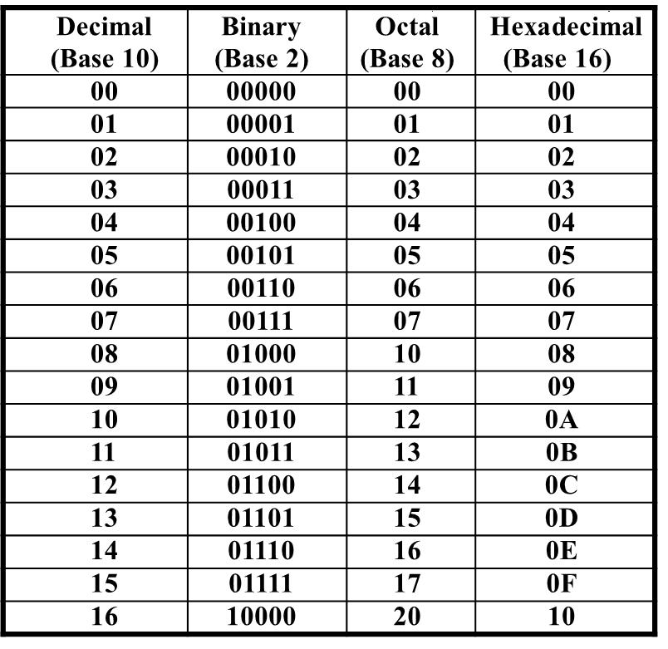
Different Radixes

Slide 37
Converting R-base to Decimal
To convert to decimal, use decimal arithmetic to form Σ (digit × respective power of R).
Convert (100101.01)2to N₁₀:
1*2⁵+0*2⁴+0*2³+1*2²+0*2¹+1*2⁰+0*2⁻¹+1*2⁻²=(37.25)10
Convert 3A.CH to N₁₀:
3*16¹+10*16⁰+12*16⁻¹=(58.75)10

Slide 38
Converting Decimal to R-base
To convert from one base to another:
Convert the integer part
Convert the fraction part
Join the two results together

Slide 39
Convert the Integral Part
Repeatedly divide the number by the new radix and save the remainders. The digits for the new radix are the remainders in reverse order of their computation.
If the new radix is > 10, then convert all remainders > 10 to digits A, B, …
Notes:
除基取余，上低下高，用转换的十进制数除以R，得到的余数作为结果数据各位的数字，直到上商为0为止。
先得到的余数作为右边低位上的数位，后得到的余数作为左边高位上的数位。

Slide 40
Example: Convert 135₁₀ To Base 2
(135)10 = (1000 0111)2
2 1 3 5
2 6 7…………1
2 3 3…………1
2 1 6…………1
2 8…………0
2 4…………0
2 2…………0
2 1…………0
2 0…………1
Notes:
除基取余，上低下高，用转换的十进制数除以R，得到的余数作为结果数据各位的数字，直到上商为0为止。
先得到的余数作为右边低位上的数位，后得到的余数作为左边高位上的数位。
135 % 8 = 7
16 % 8 = 0
2 % 8 = 2
-------------
207

Slide 41
Convert the Fractional Part
Repeatedly multiply the fraction by the new radix and save the integer digits that result. The digits for the new radix are the integer digits in order of their computation.
If the new radix is > 10, then convert all remainders > 10 to digits A, B, …
Notes:
乘基取整，上高下低，用转换的十进制数乘以R，得到的整数部分作为结果数据各位的数字，小数部分继续与R相乘，以此类推，指导某一部乘积的小数部分为0或已得到希望的位数为止。
先得到的整数作为左边高位上的数位，后得到的整数作为右边低位上的数位。

Slide 42
Example: Convert 0.6875₁₀ To Base 2
(0.6875)10 = (0.1011)2
2× 0.6875………… = 1.375
2× 0.375………… = 0.75
2× 0.75………… = 1.5
2× 0.5………… = 1
Notes:
乘基取整，上高下低，用转换的十进制数乘以R，得到的整数部分作为结果数据各位的数字，小数部分继续与R相乘，以此类推，指导某一部乘积的小数部分为0或已得到希望的位数为止。
先得到的整数作为左边高位上的数位，后得到的整数作为右边低位上的数位。
8 * 0.6875 = 5.5
8 * 0.5 = 4.0
-------------------
0.6875 = 0.54O

Slide 43
Convert 135.6875₁₀ To Base2
Convert 135 to Base 2
Convert 0.6875 to Base 2:
Join the results together
(135)10 = (10000111)2
(0.6875)10 = (0.1011)2
(135.6875)10 = (10000111.1011)2

Slide 44
Additional Issue - Fractional Part
Note that in this conversion, the fractional part can become 0 as a result of the repeated multiplications.
In general, it may take many bits to get this to happen or it may never happen.
Example Problem: Convert 0.65₁₀ to N₂
0.65 = 0.1010011001001 …
The fractional part begins repeating every 4 steps yielding repeating 1001 forever!
Solution: Specify number of bits to right of radix point and round or truncate to this number.
Notes:
0.65
2 * 0.65 = 1.3
2 * 0.3 = 0.6
2 * 0.6 = 1.2
2 * 0.2 = 0.4
2 * 0.4 = 0.8
2 * 0.8 = 1.6
2 * 0.6 = 1.2
2 * 0.2 = 0.4
2 * 0.4 = 0.8
2 * 0.8 = 1.6
2 * 0.6 = 1.2
2 * 0.2 = 0.4
2 * 0.4 = 0.8
2 * 0.8 = 1.6
…
----------------
0.10 1001 1001 1001…

Slide 45
Why Do Repeated Division and Multiplication Work?
Divide the integer portion of the power series by radix r. The remainder of this division is A₀, represented by the term A₀/r.
Discard the remainder and repeat, obtaining remainders A₁, …
Multiply the fractional portion of the power series by radix r. The integer part of the product is A₋₁.
Discard the integer part and repeat, obtaining integer parts A₋₂, …
This demonstrates the algorithm for any radix r >1.
Notes:
Note that the powers of r decline by 1 in the quotient and that a fraction a₀/r results, giving a₀ as the remainder.
The next time, fraction a₁/r results giving a₁ as the remainder.
In general, the remainder will be a_{i} for the ith step.
At the nth step, a_{n}/r will result with the quotient = 0.
Similarly, for multiply, a_{–1} will emerge as the integral part first since r x r ^{–1} = 1.

Slide 46
Octal (Hexadecimal) to Binary and Back
Octal (Hexadecimal) to Binary:
Restate the octal (hexadecimal) as three (four) binary digits starting at the radix point and going both ways.
Binary to Octal (Hexadecimal):
Group the binary digits into three (four) bit groups starting at the radix point and going both ways, padding with zeros as needed in the fractional part.
Convert each group of three bits to an octal (hexadecimal) digit.

Slide 47
Hexadecimal to Binary and Back
(0)H = 0000 (1)H = 0001
(2)H = 0010 (3)H = 0011
(4)H = 0100 (5)H = 0101
(6)H = 0110 (7)H = 0111
(8)H = 1000 (9)H = 1001
(A)H = 1010 (B)H = 1011
(C)H = 1100 (D)H = 1101
(E)H = 1110 (F)H = 1111

Slide 48
Some Examples
(67.731) ₈ ＝（110 111 .111 011 001)₂
(312.64)₈＝(011 001 010 . 110 1)₂
(11 111 101 . 010 011 11)₂＝(375.236)₈
(10 110.11)₂＝(26.6)₈
(2B.5E) ₁₆ ＝（0010 1011.0101 1110)₂
(21A.5)₁₆＝(0010 0001 1010 . 0101)₂
(1001101.01101)₂= ( 0100 1101. 0110 1000 )₂=(4D.68)₁₆
(110 0101.101)₂＝(65.A)₁₆

Slide 49
Octal to Hexadecimal via Binary
Convert octal to binary.
Use groups of four bits and convert as above to hexadecimal digits.
Example: Octal to Binary to Hexadecimal
6 3 5 . 1 7 7 ₈
110｜011｜101 . 001｜111｜1112
1｜1001｜1101 . 0011｜1111｜1(000)2
1 9 D . 3 F 8 ₁₆
Why do these conversions work?
Notes:
Marking off in groups of three (four) bits corresponds to dividing or multiplying by 2³ = 8 (2⁴ = 16) in the binary system.

Slide 50
Simple BASE CONVERSION(From Decimal to Binary) - Positive Powers of 2
Useful for Base Conversion
Exponent
Value
Exponent
Value
0
1
11
2,048
1
2
12
4,096
2
4
13
8,192
3
8
14
16,384
4
16
15
32,768
5
32
16
65,536
6
64
17
131,072
7
128
18
262,144
8
256
19
524,288
9
512
20
1,048,576
10
1024
21
2,097,152
Notes:
x > 2^n, e.g., 8261
8261 - 8192 = 69 ; 2^13
69 – 64 = 5; 2^6
5 – 4 = 1; 2^2
1 – 1 = 0; 2^0
--------------------------
10 0000 0100 0101B
x < 2^n, e.g., 8161
d = 8192 - 1 – 8161 = 30 = 1 1110B
30 – 16 = 14
14 – 8 = 6
6 – 4 = 2
2 – 2 = 0
-------------------------
1 1111 1111 1111 – 1 1110 = 1 1111 1110 0001B

Slide 51
Special Powers of 2
2¹⁰ (1024) is Kilo, denoted "K"
2²⁰ (1,048,576) is Mega, denoted "M"
2³⁰ (1,073, 741,824)is Giga, denoted "G"
2⁴⁰ (1,099,511,627,776 ) is Tera, denoted “T"
Notes:
1PB = 1024TB
1EB = 1024PB

Slide 52
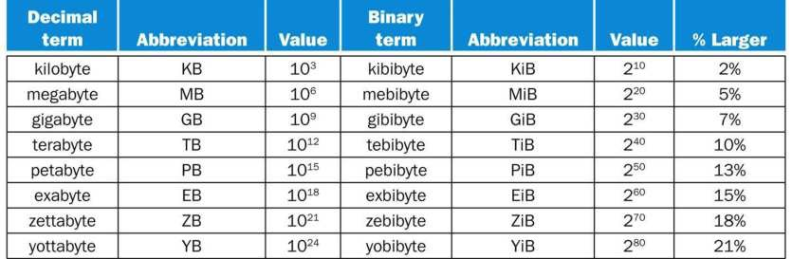
2^{X} vs. 10^{Y} Bytes Ambiguity
Notes:
The 2^{X} vs. 10^{Y} bytes ambiguity was resolved by adding a binary notation for all the common size terms.

Slide 53
Overview
Introduction to computer systems
Binary number representation
Arithmetic operations
Representation of numeric data
Representation of non-numeric data
Data width and storage

Slide 54
ARITHMETIC OPERATIONS - Binary Arithmetic
Single bit addition with carry
Multiple bit addition
Single bit subtraction with borrow
Multiple bit subtraction
Multiplication
Division
Notes:
课件小typo我

Slide 55
Single Bit Binary Addition with Carry

Slide 56
Multiple Bit Binary Addition
Extending this to two multiple bit examples:
Carries 0 0
Augend 01100 10110
Addend +10001 +10111
Sum
Note: The 0 is the default Carry-In to the least significant bit.
11100
101101

Slide 57
Single Bit Binary Subtraction with Borrow
Given two binary digits (X,Y), a borrow in (Z) we get the following difference (S) and borrow (B):
Borrow in (Z) of 0:
Borrow in (Z) of 1:
Z
0
0
0
0
X
0
0
1
1
- Y
-0
-1
-0
-1
B S
0 0
1 1
0 1
0 0
Z
1
1
1
1
X
0
0
1
1
- Y
-0
-1
-0
-1
B S
1 1
1 0
0 0
1 1

Slide 58
Multiple Bit Binary Subtraction
Extending this to two multiple bit examples:
Borrows 0 0
Minuend 10110 10110
Subtrahend - 10010 - 10011
Difference
Notes: The 0 is a Borrow-In to the least significant bit. If the Subtrahend > the Minuend, interchange and append a – to the result.
00100
00011

Slide 59
Binary Multiplication
Notes:
11011.101 * 101.111 = 10100010.010011
1 1 0 1 1 . 1 0 1
1 0 1 . 1 1 1
---------------------------
1 1 0 1 1 . 1 0 1
1 1 0 1 1 1 . 0 1 ← First partial product
---------------------------
1 0 1 0 0 1 0 1 1 1 ← First intermediate sum
1 1 0 1 1 1 0 1
---------------------------
1 1 0 0 0 0 0 1 0 1 1 ← Second intermediate sum
1 1 0 1 1 1 0 1
---------------------------
1 1 0 0 1 1 1 1 0 0 1 1 ← Third intermediate sum
1 1 0 1 1 1 0 1
---------------------------
1 0 1 0 0 0 1 0 0 1 0 0 1 1

Slide 60
Binary Division
Notes:
11101.01 ÷ 1100 = 10.0111
1100) 11101.01 (10.0111
1100
---------
10101
1100
---------
0010
1100
---------
1100
1100
---------
10110.1 ÷ 1101 -> the quotient is 1.101 upto 3 places of binary point and the remainder is 1.011.
1101) 10110.1 (1.101
1101
---------
10011
1101
---------
11000
1101
---------
1011
101.11 ÷ 111 -> the quotient is 0.11 upto 2 places of binary point and the remainder is 0.1.
111) 101.11 (0.11
11 1
---------
10 01
1 11
---------
10

Slide 61
A Final Conversion Note
You can use arithmetic in other bases if you are careful:
Example: Convert 101110₂ to Base 10 using binary arithmetic:
Step 1 101110 / 1010 = 100 r 0110
Step 2 100 / 1010 = 0 r 0100
Converted Digits are 0100₂ | 0110₂
or 4 6 ₁₀

